Slide 1
Windows Forms and WPF
With net core 3

Slide 2


Who am i
Microsoft azure MVP
Founder of sia consulting limited
Cloud architect
Gdpr compliant architecture

Slide 3
Why NET Core 3
Availability
Net core is the future
Net framework ends with 3.8
Access all new c# 8 features
Performance
All performance improvements to net core included
Security
Support for net framework will eventually end
Support on windows 10
Support for winui through xaml-islands
Maintainablity
Open source

Slide 4
Features & Limitations
MSIX self-contained support
Xaml islands / winui
New json support (net core 3)
New assembly load context for better plug-in support
Winrt
Windows only
X86 & x64 only
16 types missing on a total of 4.095 public types*
The 52 public methods missing on a total of 42.645 public methods*
* as of 28/20/2019

Slide 5


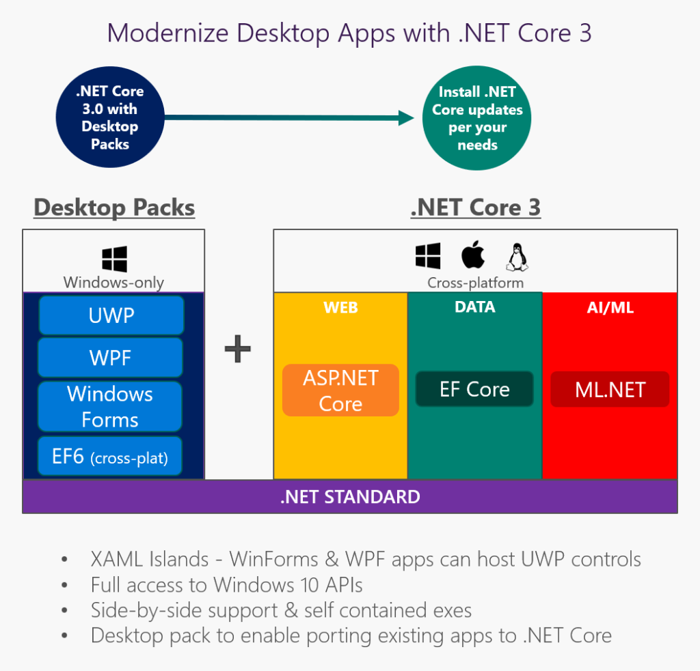

Slide 6
Getting started
Download latest net core 3
Download MS Portability-analyzer
Create new SDK-style project file
Add missing parts to project file
Copy files
f5

Slide 7

Demo portability analyzer

Slide 8
New application
Dotnet new winforms
Open in VS 2019

Slide 9
Demo new project

Slide 10
Migration class libraries
Create new sdk-style project file
Target net standard
If needed install Microsoft.Windows.Compability-pack

Slide 11
Demo Migration class libraries

Slide 12
Migration windows forms
Create new sdk-style project
<UseWindowsforms>true</usewindowsforms>
Include cs files
Include embeddedresources
Open in VS 2019

Slide 13
Demo Migration Windows forms

Slide 14
Migration wpf
Create new sdk-style project
<usewpf>true</usewpf>
Include cs files
Include embeddedresources
Include xaml files
Open in VS 2019

Slide 15
Demo Migration wpf

Slide 16

Thanks

Slide 17
Resources
https://blog.ndepend.com/net-core-3-0-support-for-wpf-and-winforms-apis/
https://devblogs.microsoft.com/dotnet/net-core-3-and-support-for-windows-desktop-applications/
https://devblogs.microsoft.com/dotnet/announcing-net-core-3-preview-1-and-open-sourcing-windows-desktop-frameworks/
https://devblogs.microsoft.com/dotnet/how-to-port-desktop-applications-to-net-core-3-0/

